Slide 1
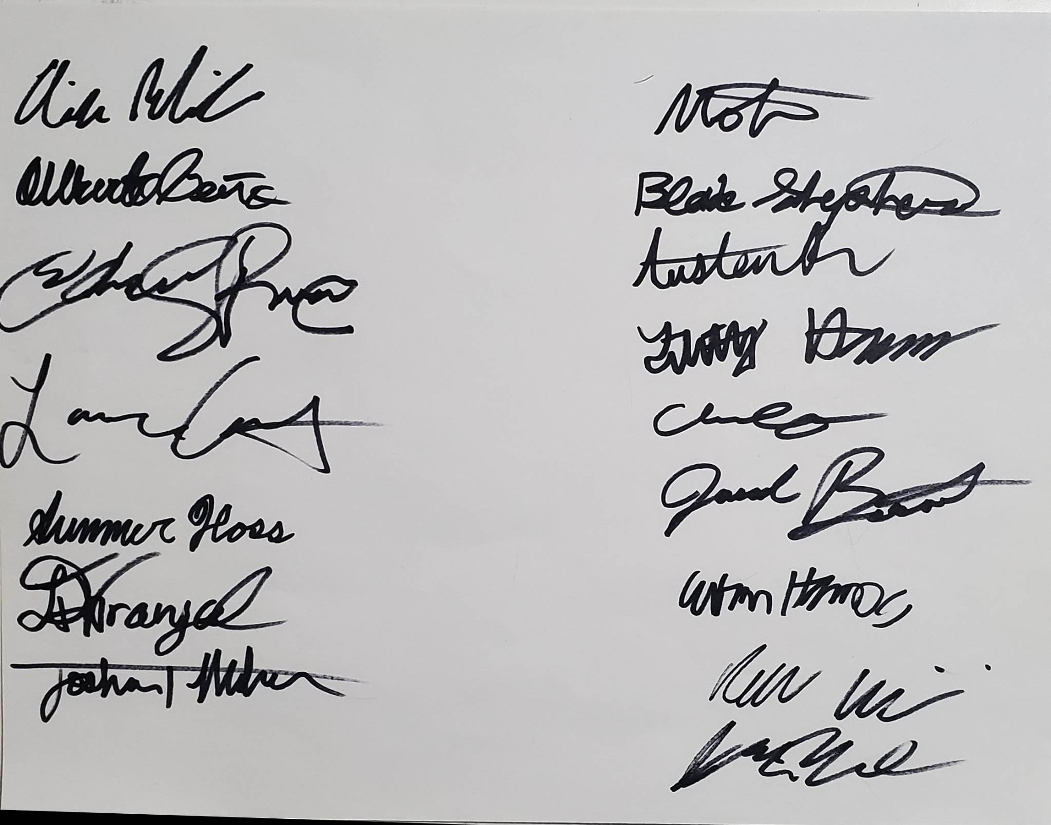

Slide 2

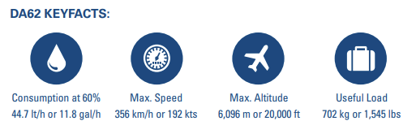
MTOW
Cruise
Stall
Max Altitude
564 lbs
33 KCAS
23 KCAS
3000’
∞ Range*
0 Emissions
1000’ Runway

Slide 3
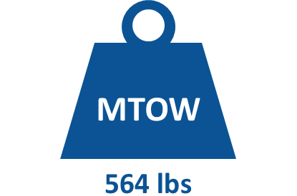
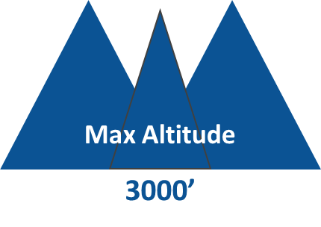
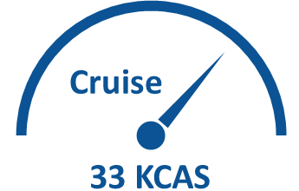
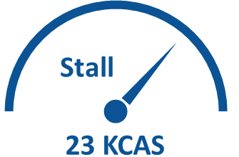


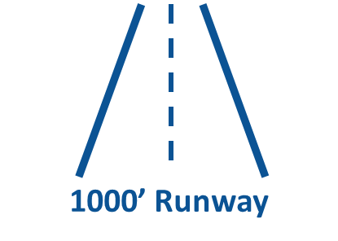

Slide 4
Sensors
Pilot Information
Total Energy Probe
Altitude & Vertical Speed
Pilot Action
Instruments
Pitot Tube
Variometer
Airspeed
Pitch / Roll
Center Stick
Garmin G5
Rudder Pedals
Static Port
Heading & Ground Track
Air & Sea Radio
Throttle Levers
GPS Antenna
Pitch, Roll, Yaw
Angles
Custom
EPFD
Air & Sea
Communication
Lights & Radios
VHF AM & FM Antenna
Temp, RPM, & Voltage Sensors
EPU Monitoring

Slide 5
Sensors
Instruments
Pilot Info

Slide 6
Pick Stable
Tail Volumes
Relate Length & Stabilizer Area
Estimate Weight per unit dimension
Tail Dimensions at Min Weight
Structural Analysis

Slide 7

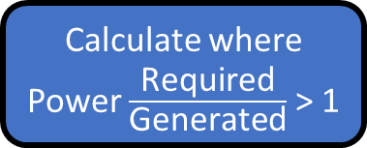
Fixed Lift, Variable Speed Analysis
Initial Design:
[C_{Dp} C_{Di} C_{L} AR e]
Weight Estimate
Drag Build-Up
Of Bodies
Determine Lowest T/W
Calculate where Power $\frac{\text{Required}}{\text{Generated}}$ > 1
Use Smallest Wing Area + Mass
Propulsive
Efficiencies
Modify Wing to meet initial design
Calculate where Power $\frac{\text{Required}}{\text{Generated}}$ > 1

Slide 8
Simulation
Requirements:
Water Take-Off
<1000’ at 50’ tree
Simulation Constants
Boundary Value Problem (2nd Order)
Find Lowest Thrust & Power
Propulsion Requirements
Aircraft Lift & Drag Polars

Slide 9
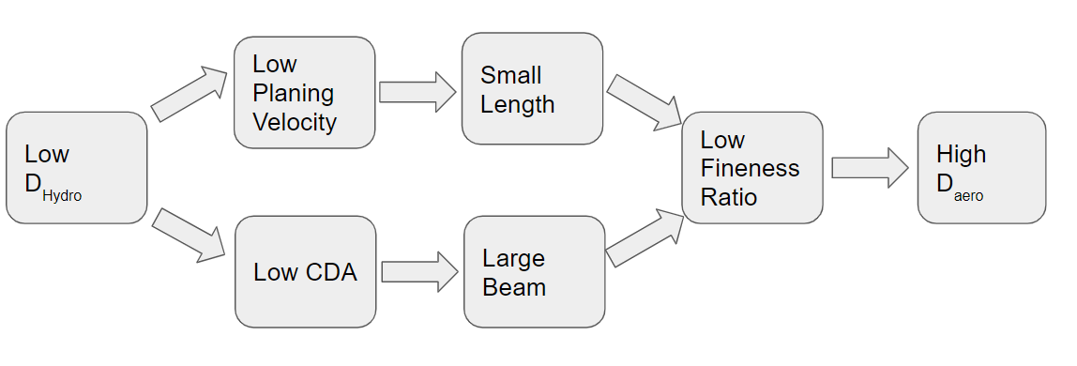
Sizing CDA not on minimizing Drag outright, but by minimizing the thrust needed to take off, which is not necessarily the same
For a fixed beam length, we find an appropriate length and cda.
With such CDA, we run a takeoff sim and note the thrust
We iterate iterate over a few CDAs to find an acceptable estimated thrust to take off
The dimensions associated with the smallest estimated thrust are final
Guess alpha & L
Compute CL
Cl sets surface area
Set b -> SA becomes an L
(redo loop)
Keep going until output L is same as L input
This is min CDA
This min CDA sets the p-speed b/c Froude #
P-speed and CDA in takeoff sim-> sets thrust required.
Iterate until cda&&p-speed result in acceptable thrust
If we optimized hydro drag, we’d make a short fat fuselage, so clearly we need to set some variables, being the beam length & Froude number.
Fixed Beam Length
Guess input length
Compute C_{L} which sets AR
Is Output Length
= Input Length?
CDA has Converged
V_{p} & α set by CDA
Final Dimensions
Does T↓ if CDA↑, VP ↓?
Min Required Thrust for T/O given CDA, V_{p}
T/O Sim with CDA & V_{p}

Slide 10
If we optimized hydro drag, we’d make a short fat fuselage, so clearly we need to set some variables, being the beam length & Froude number.
Sizing CDA not on minimizing Drag outright, but by minimizing the thrust needed to take off, which is not necessarily the same
For a fixed beam length, we find an appropriate length and cda.
With such CDA, we run a takeoff sim and note the thrust
We iterate iterate over a few CDAs to find an acceptable estimated thrust to take off
The dimensions associated with the smallest estimated thrust are final
Low V_{p}
Low Hydro- Dynamic Drag
Low Aspect Ratio
Fix Beam Length & Froude #
Large Beam
Low CDA
Low Aero- Dynamic Drag
High Aspect Ratio
Find length as function of V_{p}

